Slide 1
Building API’s in GraphQL
Liam Norman | May 2019 | DeveloperUG

Slide 2

HELLO!
✋
I am Liam Norman
Software Engineer at Superbalist.com
Organiser of CT PHP
Blog at liamnorman.com
@liamjnorman

Slide 3
What is GraphQL?
Notes:
Let’s first start off with what GraphQL is

Slide 4
GraphQL is a query language for your API, and a server-side runtime for executing queries by using a type system you define for your data
Notes:
GraphQL is a query language for your API, and a server-side runtime for executing queries by using a type system you define for your data.
GraphQL isn't tied to any specific database or storage engine and is instead backed by your existing code and data.
More on that later

Slide 5
WHAT IS GRAPHQL?
An API query language
Developed by Facebook in 2012
Not only to be used with React!
Open sourced by facebook in 2015 - https://graphql.github.io/graphql-spec/
Notes:
What is GraphQL?

Slide 6
DESIGN PRINCIPLES
Hierarchical
Product Centric
Strong Typing with Schemas
Client-specified Queries
Introspective
Notes:
Hierarchical
A GraphQL query is hierarchical. Fields are nested within other fields and the query is shaped like the data that it returns.
Product centric
GraphQL is driven by the data needs of the client and the language and runtime that support the client.
Strong typing
A GraphQL server is backed by the GraphQL type system. In the schema, each data point has a specific type against which it will be validated.
Client-specified queries
A GraphQL server provides the capabilities that the clients are allowed to consume.
Introspective
The GraphQL language is able to query the GraphQL server’s type system.

Slide 7
Why GraphQL?

Slide 8
PROBLEMS GRAPHQL SOLVES
Declarative Data Fetching
No Overfetching
Solves Underfetching
Language and framework independent
Notes:
Declarative Data Fetching - As you’ve seen, GraphQL embraces declarative data fetching with its queries. The client selects data along with its entities with fields across relationships in one query request. GraphQL decides which fields are needed for its UI, and it almost acts as UI-driven data fetching, like how Airbnb uses it. A search page at Airbnb usually has a search result for homes, experiences, and other domain-specific things. To retrieve all data in one request, a GraphQL query that selects only the part of the data for the UI makes perfect sense. It offers a great separation of concerns: a client knows about the data requirements; the server knows about the data structure and how to resolve the data from a data source (e.g. database, microservice, third-party API).
No Overfetching with GraphQL -
There is no overfetching in GraphQL. A mobile client usually overfetches data when there is an identical API as the web client with a RESTful API. With GraphQL, the mobile client can choose a different set of fields, so it can fetch only the information needed for what’s onscreen.
Solves Underfetching - Our project manager just showed up at our desk and wants to add another feature to the Star Wars app. In addition to name, height, and mass, we now need to display a list of movie titles for all films that Luke Skywalker is in. After we request the data from https://swapi.co/api/people/1/, we still need to make additional requests for more data. This means we underfetched.
GraphQL is language and framework independent - GraphQL is not just exciting for React developers, though. While Facebook showcased GraphQL on a client-side application with React, it is decoupled from any frontend or backend solution.

Slide 9
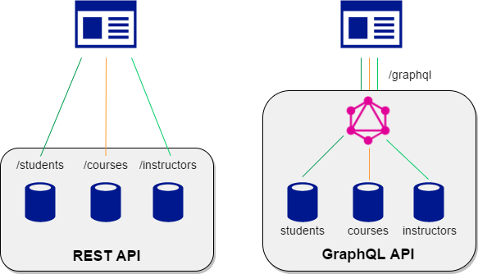
HOW GRAPHQL WORKS
Notes:
REST API = has many endpoints, lots of calls.
GraphQL is less chatty and instead we query a GraphQL server which hosts our API and we use the /graphql endpoint. Every request using GraphQL goes to the /graphql endpoint so we only have to manage one endpoint. GraphQL also allows us to fetch multiple resources at once using resolvers.

Slide 10






GraphQL Adoption
Notes:
GraphQL is used by quite a few companies such as GitHub, Facebook, Coursera, Shopify, Wordpress and Twitter so it is quite established and adopted and not a flaky technology.
No Overfetching with GraphQL -
There is no overfetching in GraphQL. A mobile client usually overfetches data when there is an identical API as the web client with a RESTful API. With GraphQL, the mobile client can choose a different set of fields, so it can fetch only the information needed for what’s onscreen.
GraphQL is language and framework independent - GraphQL is not just exciting for React developers, though. While Facebook showcased GraphQL on a client-side application with React, it is decoupled from any frontend or backend solution.

Slide 11
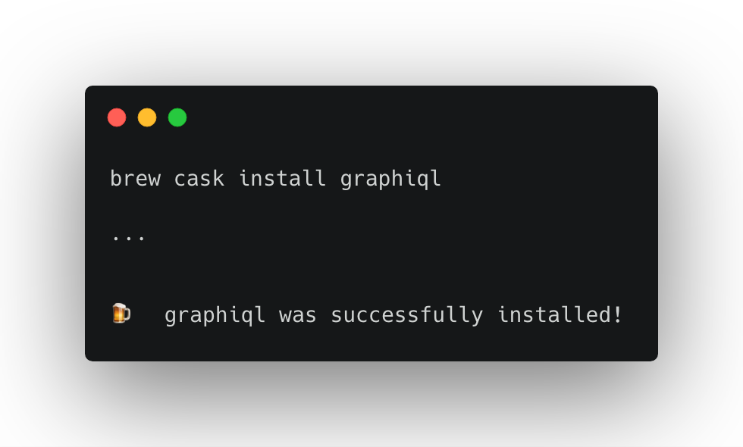
Our first Query!
Using GraphiQL client
Notes:
A Query is a GraphQL type. We call it a root type because it’s a type that maps to an operation, and operations represent the roots of our query document. The fields that are available to query in a GraphQL API have been defined in that API’s schema. The documentation will tell us what fields are available to select on the Querytype.
When we write queries, we are selecting the fields that we need by encapsulating them in curly brackets. These blocks are referred to as selection sets.
You can nest selection sets within one another.

Slide 12
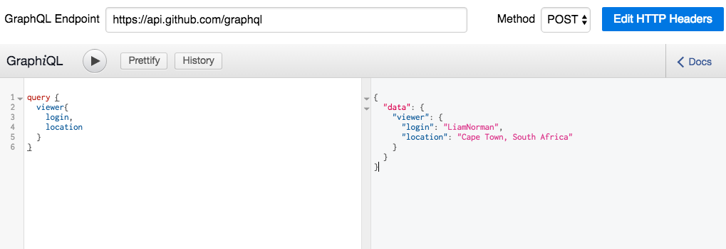
Example GraphQL Query
Notes:
This is a super simple query against the GraphQL API using GraphiQL, we are authenticated and fetching our user’s login and location.

Slide 13
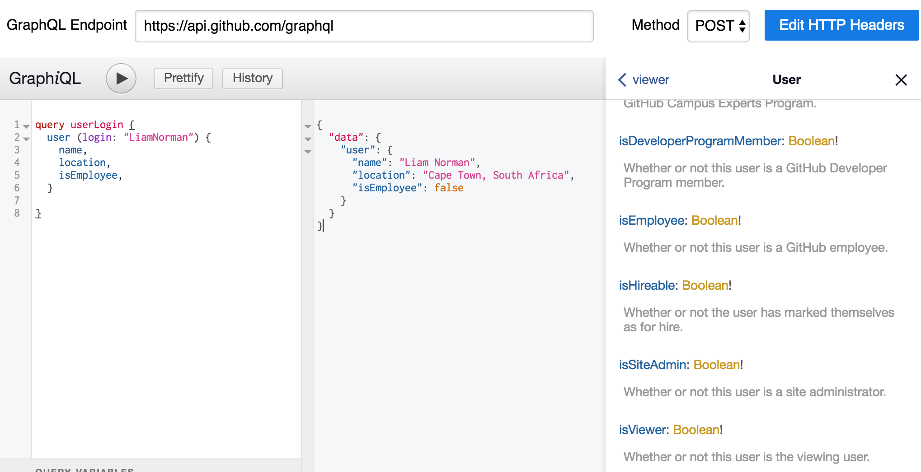
Query Arguments
Notes:
A way to filter the results of a GraphQL query is to pass in query arguments. Arguments are a key–value pair (or pairs) associated with a query field.
Similar to how with REST we have query parameters.

Slide 14
Thinking in Graphs

Slide 15
With GraphQL, you model your business domain as a graph.
Notes:
GraphQL is a query language for your API, and a server-side runtime for executing queries by using a type system you define for your data.
GraphQL isn't tied to any specific database or storage engine and is instead backed by your existing code and data.
More on that later

Slide 16
Graph Theory 101 (in short)
G = (V, E)
G = Graph , V = vertices or nodes and E equals edges
Vertices = {1, 2, 3, 4}
Edges = { {1, 2}, {1, 3} etc… }
Notes:
A graph is a data structure that is defined by two components :
A node or a vertex.
An edge E or ordered pair is a connection between two nodes u,v that is identified by unique pair(u,v).

Slide 17
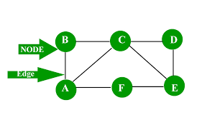
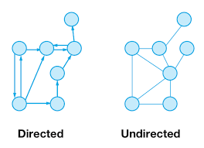
Graph Theory 101 (in short)
Notes:
To the left we can see what I meant, note that we have a connected graph with nodes and then the connections between the nodes are edges.
There are also two types of graphs namely directed and undirected. A directed graph is when every node connects to one another and you can traverse from one point of the node to another. An undirected graph is when you cannot traverse from one point of the node to another and every element is not connected.

Slide 18
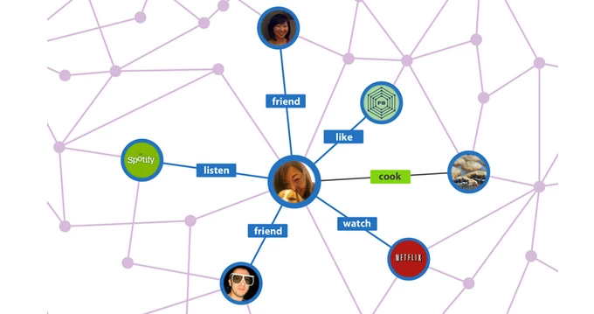
Graph Theory 101 (in short)
Notes:
That was boring but important. When we design data in GraphQL, it is important to model our data as a way we would model graphs. We are ultimately modelling our business logic. So for example, imagine if the above was a graph of a user on facebook. Note how the data of the user such as who their friends are, what they watch, what they listen to etc… translates into an undirected graph. This is one of the larger reasons why Facebook uses GraphQL as their data lends itself very well to querying using a graph data structure.

Slide 19
GraphQL Schemas
Notes:
Awesome, now let’s look at GraphQL’s type system and schema.

Slide 20
GraphQL Schemas
Schema First Design
GraphQL schemas are defined by GraphQL SDL (schema definition language)
GraphQL Schema documents are text documents that define the types available in your application
Notes:
GraphQL is going to change your design process. Instead of looking at your APIs as a collection of REST endpoints, you are going to begin looking at your APIs as collections of types. Before breaking ground on your new API, you need to think about, talk about, and formally define the data types that your API will expose. This collection of types is called a schema.

Slide 21
Defining Types
We are going to look at a podcast application called GraphPod
We are going to design a few types for our application
All schema types have the .graphql extension
First let’s learn about GraphQL Schemas and the SDL
Notes:
We are going to look at a podcast application called GraphPod.
We are going to design two main types station and podcast.
All schema types have the .graphql extension
Let’s first learn about types.

Slide 22
Types 101 - Scalar Types
GraphQL has support for various scalar types
Int
Float
String
Boolean
ID - represents unique identifier
! represents required type
Notes:
GraphQL has support for five main scalar types namely:
Int
Float
String
Boolean
ID
The exclamation mark represents a required type

Slide 23
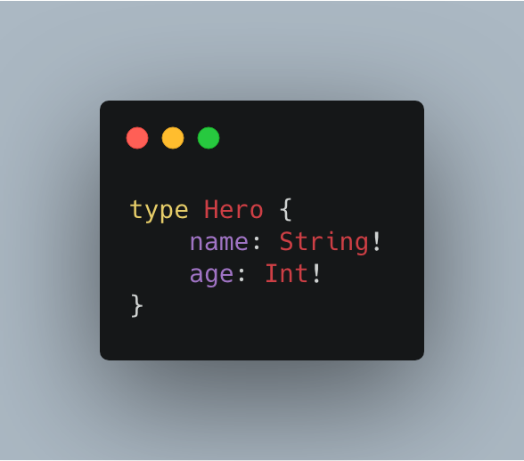
Types 101 - Object Types and Fields
The core unit of a GraphQL schema is the type. A type represents a custom object and these objects describe your application’s features
Notes:
The core unit of a GraphQL schema is the type. A type represents a custom object and these objects describe your application’s features. Above we have a simple type definition of a Hero with a name of type string and age of scalar int and they are both required fields.

Slide 24
Types 101 - Queries and Mutations
There are two types that are special namely query and mutation
Query defines that we are going to be fetching data, think of it as similar to a GET HTTP request
A mutation defines that we are going to be updating the data. Think of them as POST/PUT/DELETE HTTP requests However all requests to a GraphQL server are POST.
Notes:
An important part is queries and mutations, we have already seen what a query is.
These are two types that are special to GraphQL.
Query defines that we are going to do a query and fetch data. Think of it as a GET request.
A mutation defines that we are going to be updating the data. Think of it as doing a POST/PUT/DELETE request.

Slide 25
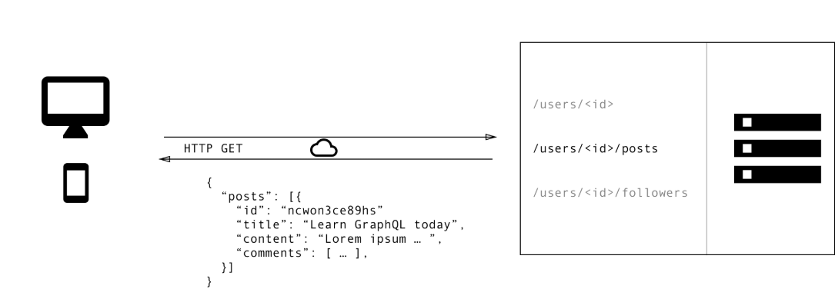
Notes:
See the above diagram, this is normally how we would do a query. We will do a GET request to a posts and retrieve all posts by a user.

Slide 26
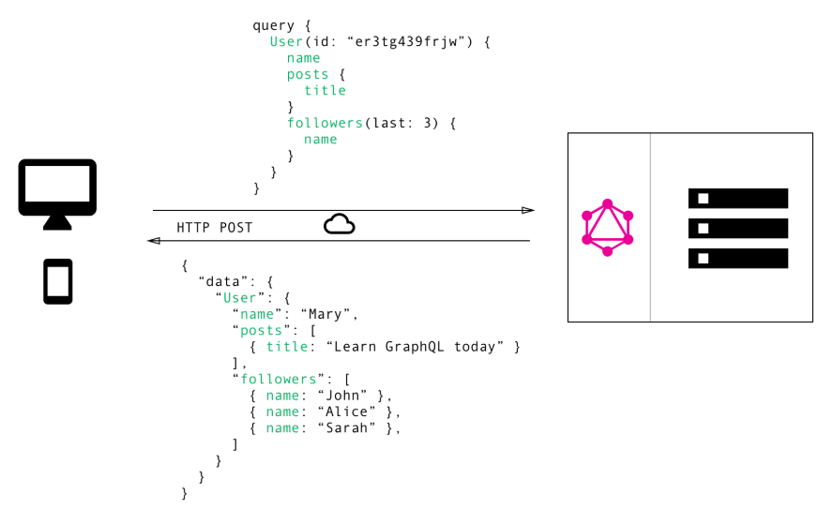
Notes:
With GRAPHQL, ALL queries are POST. So we do a post request to the /graphql/ endpoint and then teh query above gets processed by the server and we get the data below out.

Slide 27
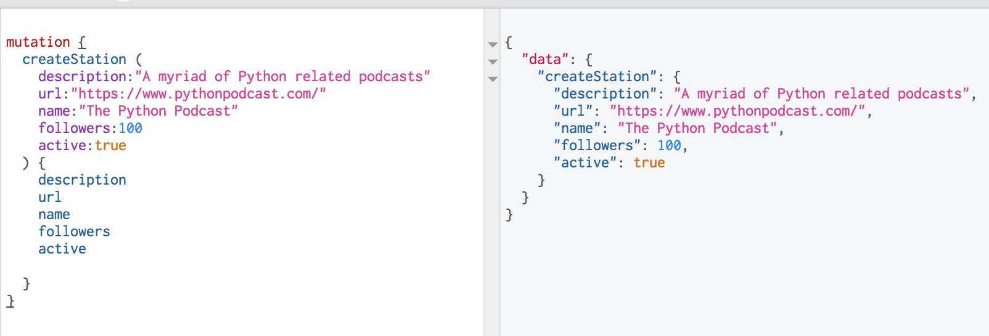
Example GraphQL Mutation
Notes:
This is an example GraphQL mutation.

Slide 28
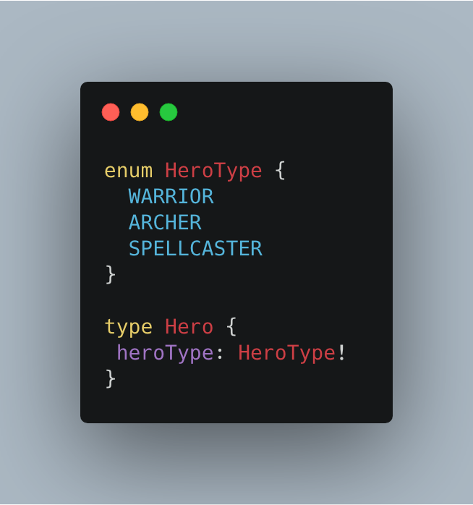
Types 101 - Enumeration fields
We can define enums using the enum type
Notes:
We can define enums using the enum type. An enum is simply an enumerated type like in Java or other programming languages.

Slide 29
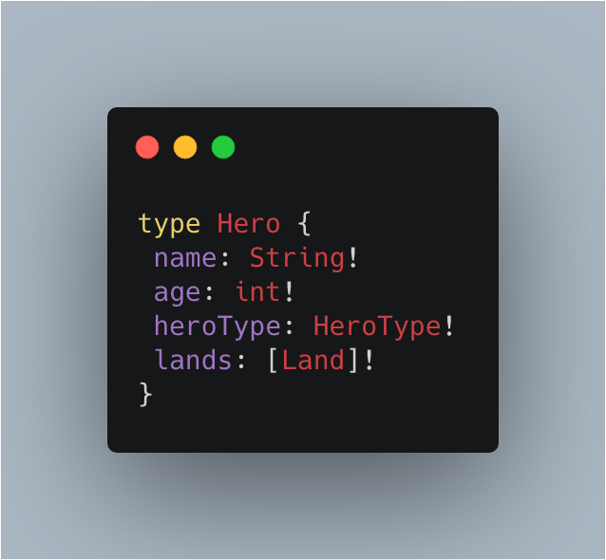
Types 101 - Lists
A list isn’t a scalar but signifies an array of object types or scalars
Notes:
A list isn’t a scalar but we can use it to store an array of object types or scalars. See below.

Slide 30
Types 101 - Interfaces
A interface is an abstract type that includes a certain set of fields that a type must implement if it implements the interface
Similar to how interfaces work in Java, PHP etc…
Interfaces are useful when you are returning objects of different types
Interfaces force validation and common design among data types
Notes:
An interface is an abstract type that includes a certain set of fields that a type must implement if it implements the interface.
Similar to how interfaces work in Java, PHP etc…
Interfaces are useful when you are returning objects of different types.
Interfaces force validation and common design among data types.

Slide 31
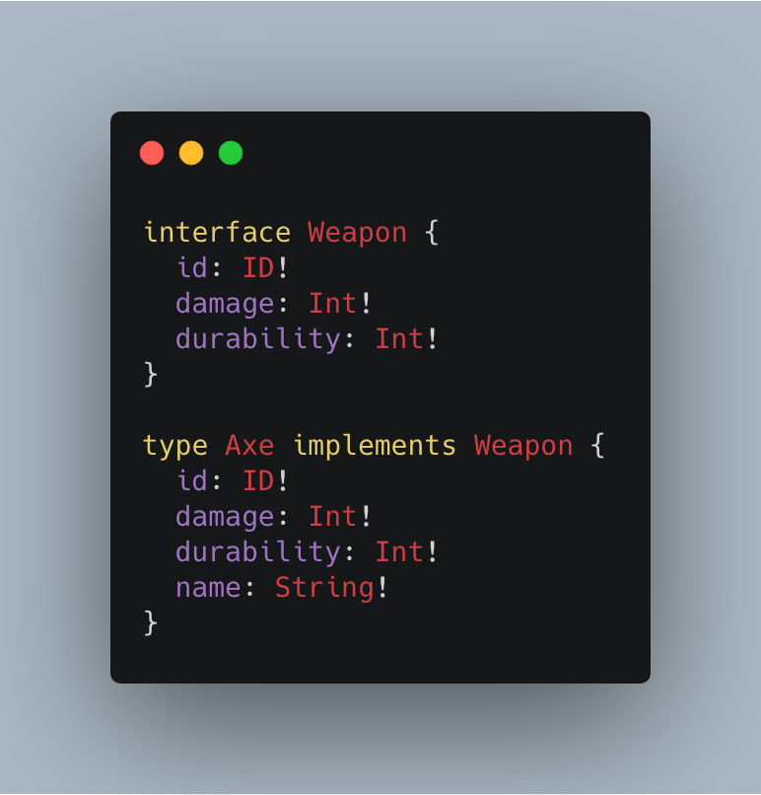
Types 101 - Interfaces
Notes:
This is an interface of Weapon which is then implemented by an Axe class.

Slide 32
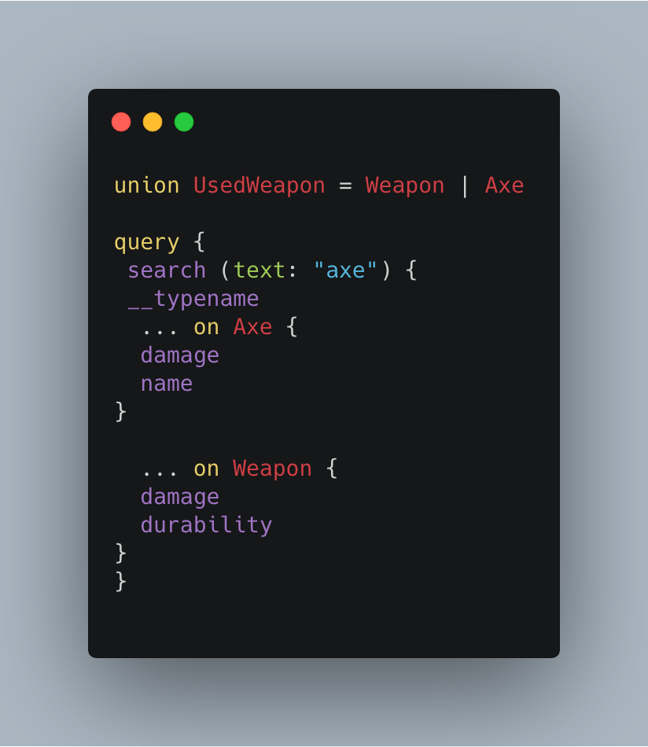
Types 101 - Unions
A union is similar to a interface except they don’t force to define common data types.
Notes:
A union is similar to a interface except that they don’t force the interfaces to define common data types. A union means that it can be one of either.
So let’s say we have a union for UsedWeapon. Meaning the UsedWeapon could be either a Weapon or an Axe DataType.
We then can do a query and return different results based upon what the UsedWeapon is. Typename automatically resolves to the Union.

Slide 33
Designing our Schema
Notes:
Awesome now let’s look at designing our first schema.

Slide 34
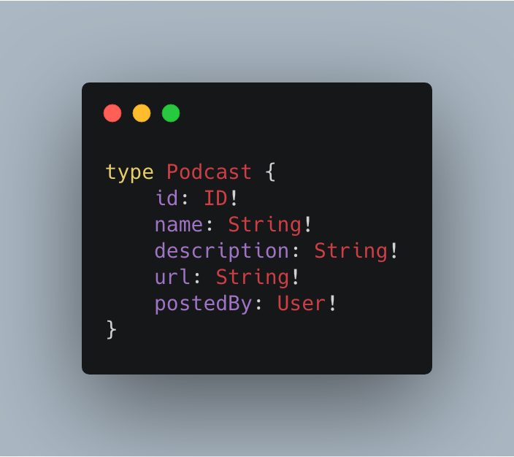
Podcast Type
Notes:
Between the curly brackets, we defined the podcast fields. We are using scalar types to define the requires fields and the exclamation point defines that all these fields are required as they are non-nullable.

Slide 35
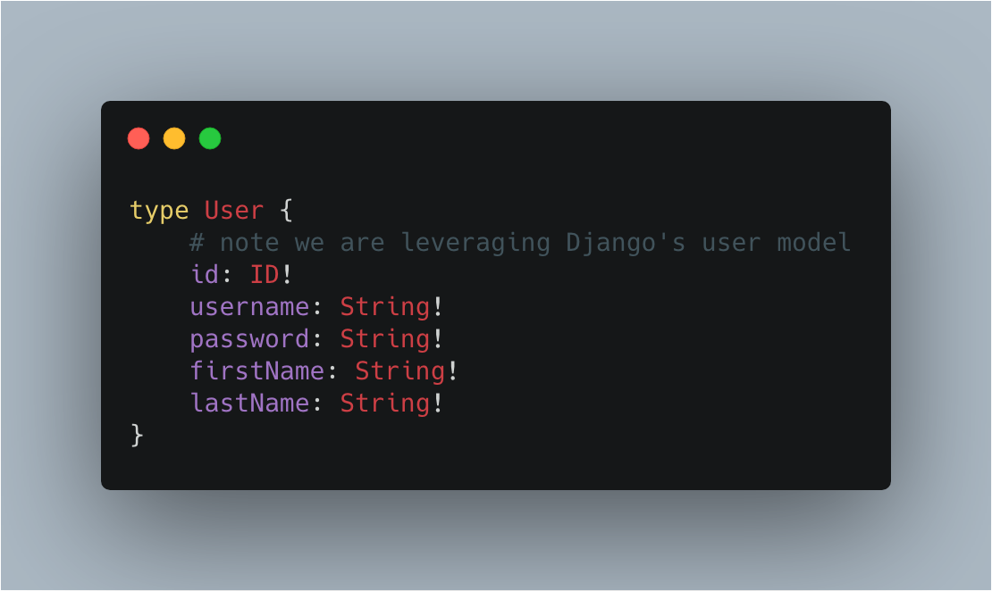
User Type
Notes:
Here we have defined a user type. We however are leveraging Django’s user model so we do have more fields available to us, this is just an example.

Slide 36
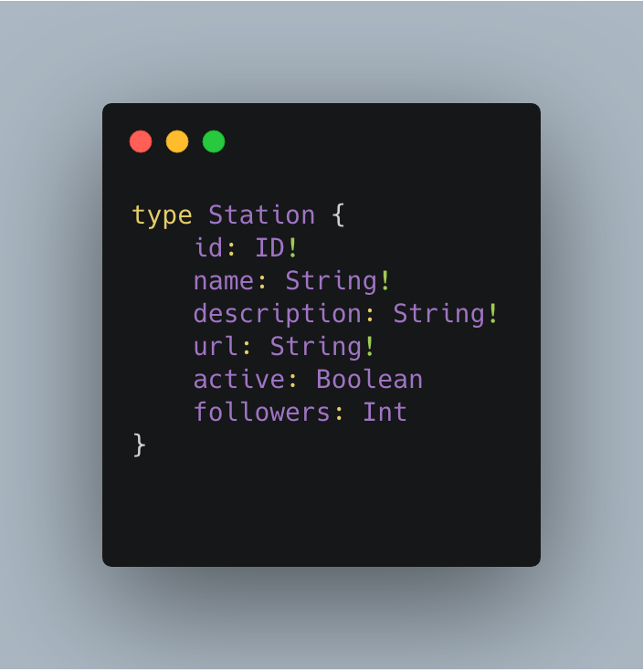
Station Type
Notes:
Between the curly brackets, we defined the station fields.

Slide 37
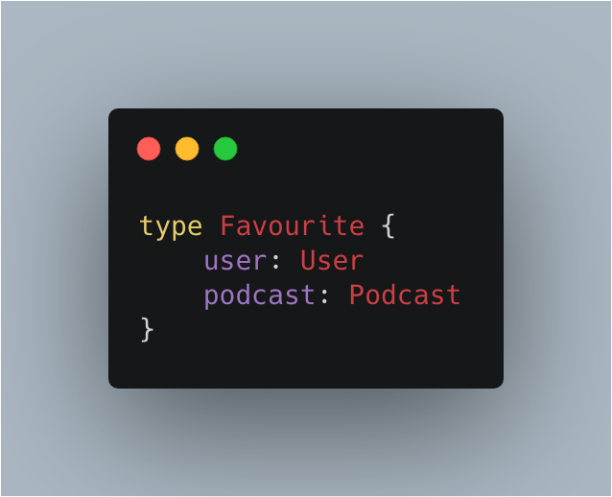
Favourite Type
Notes:
Between the curly brackets, we defined the favourite fields. We will see how we use these types soon!

Slide 38
Building a GraphQL API
Notes:
Awesome let’s look at building our GraphQL API.

Slide 39



Our Toolkit
Python 3.7
Graphene 2.0 and Graphene-Django
Django 2.1
SQLite DB
Notes:
We are going to look at a podcast application called GraphPod.
We are going to design two main types station and podcast.
The core unit of a graphql schema is the type. A type represents a custom object and these objects describe your applications features.

Slide 40
Why Graphene?
Simple and powerful
Extensible (usage with Django, SQLAlchemy etc…)
Used by Yelp, Mozilla, dailymotion etc...
Notes:
Graphene-Python is a library for building GraphQL APIs in Python easily, its main goal is to provide a simple but extendable API for making developers' lives easier.
Extensible
Industry trusted

Slide 41
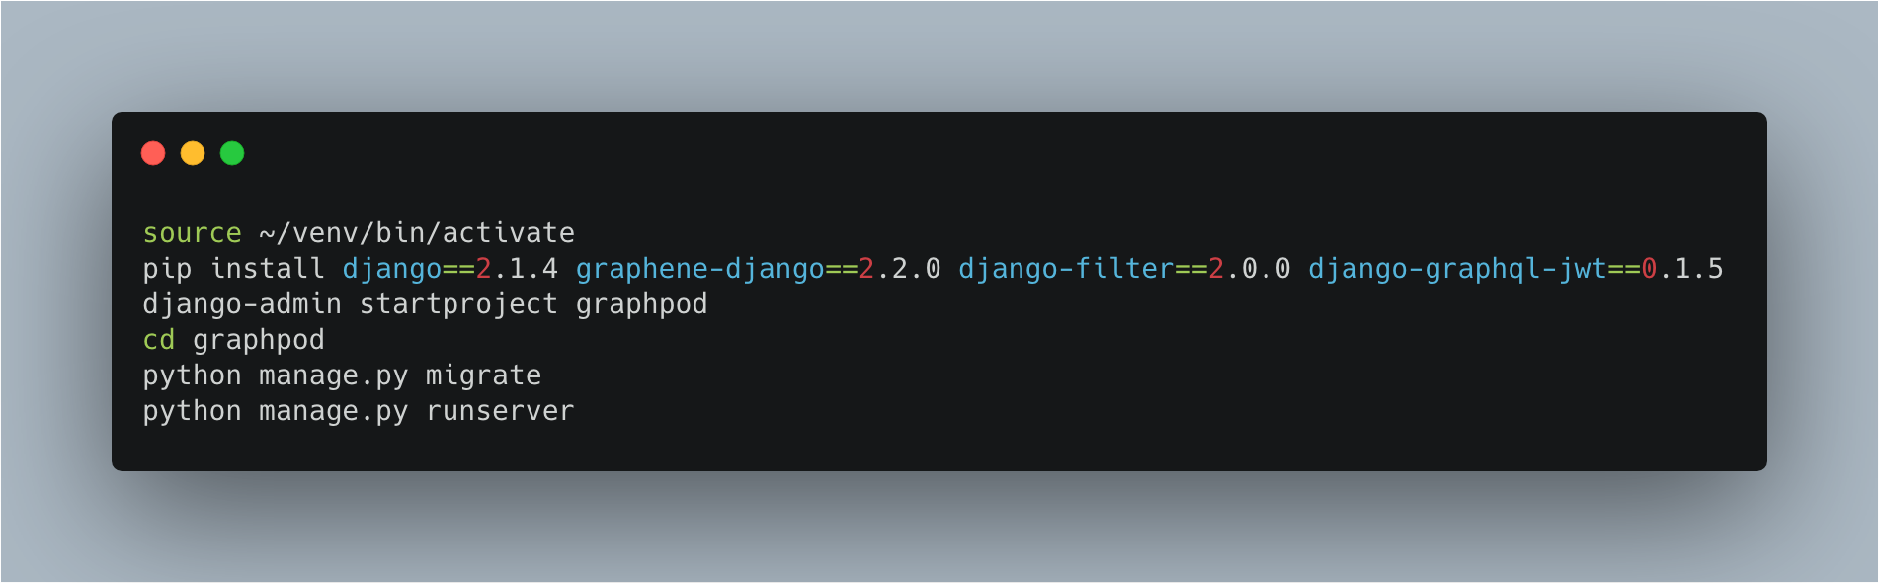
Installation
Notes:
We are going to look at a podcast application called GraphPod.
We are going to design two main types station and podcast.
The core unit of a graphql schema is the type. A type represents a custom object and these objects describe your applications features.

Slide 42
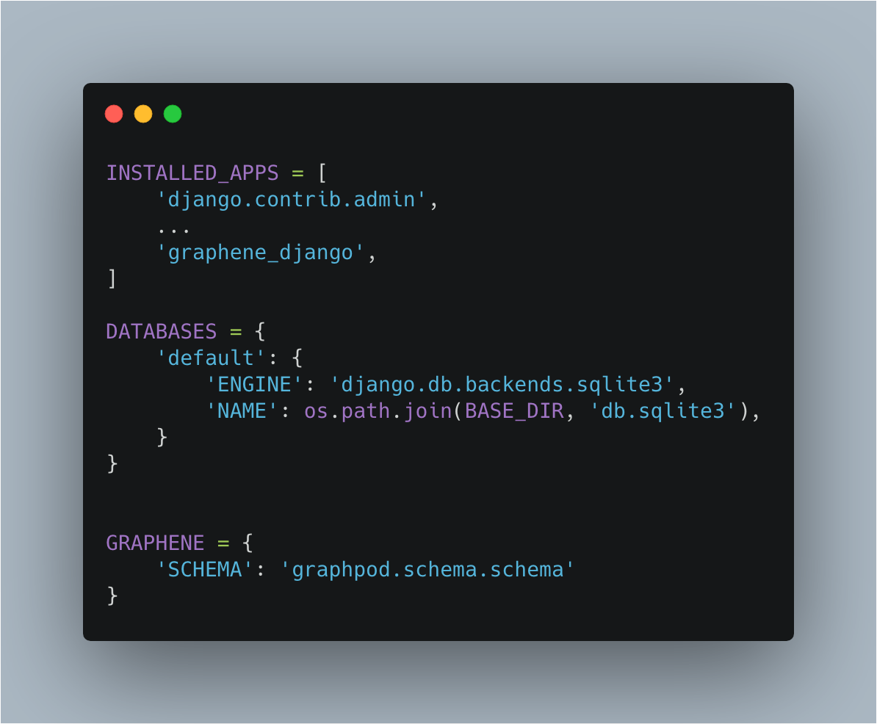
Configuring Graphene with Django

Slide 43
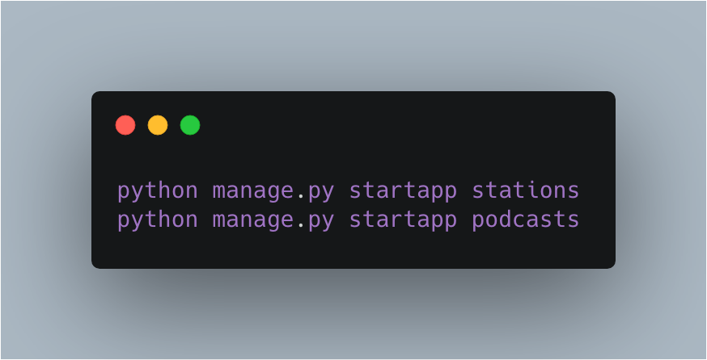
Creating our apps

Slide 44
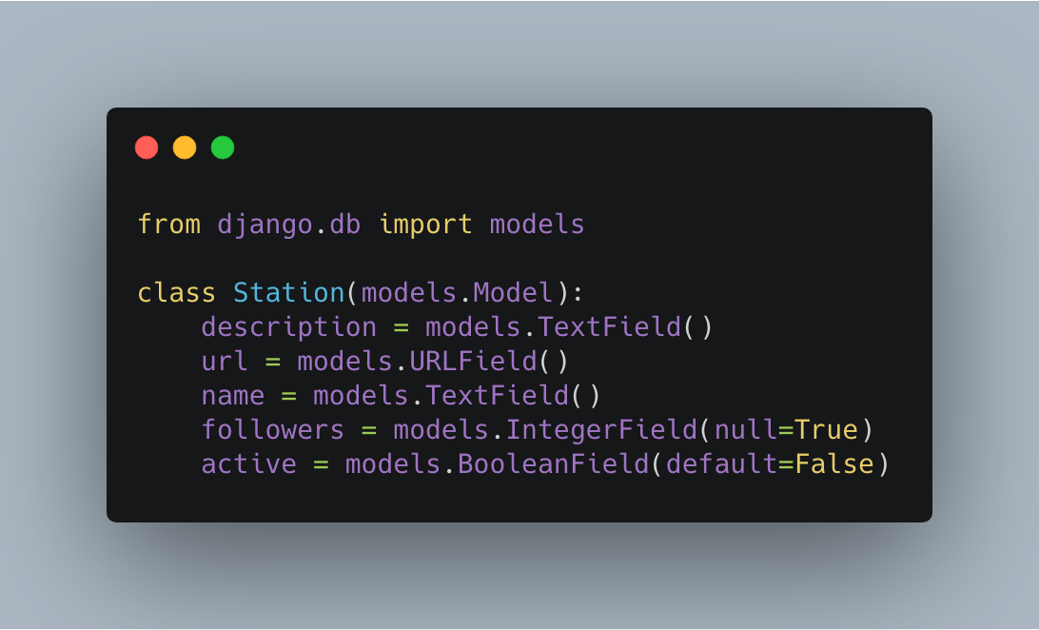
Crafting Stations - Model
Notes:
Here we craft the models, you can then run python manage.py makemigrations and python.manage.py which will migrate them.

Slide 45
Schema Organisation
Each app will have a schema.py which correlates to what mutations and queries that application can serve to our GraphQL Server
We first create a schema.py in /stations/ app
We create a base schema.py as we defined in our settings which resolves all other queries and mutations.
Notes:
One thing to note

Slide 46
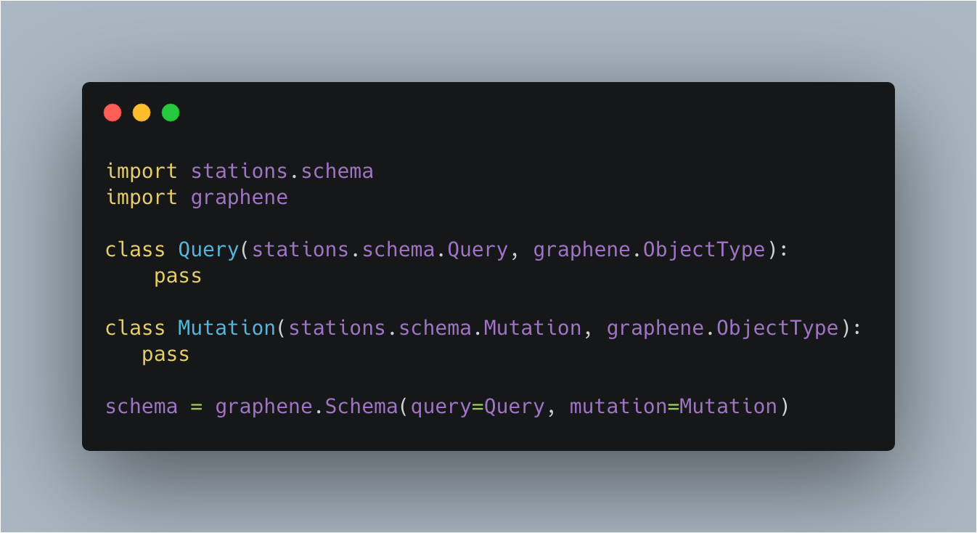
Base Schema File (as in settings.py)

Slide 47
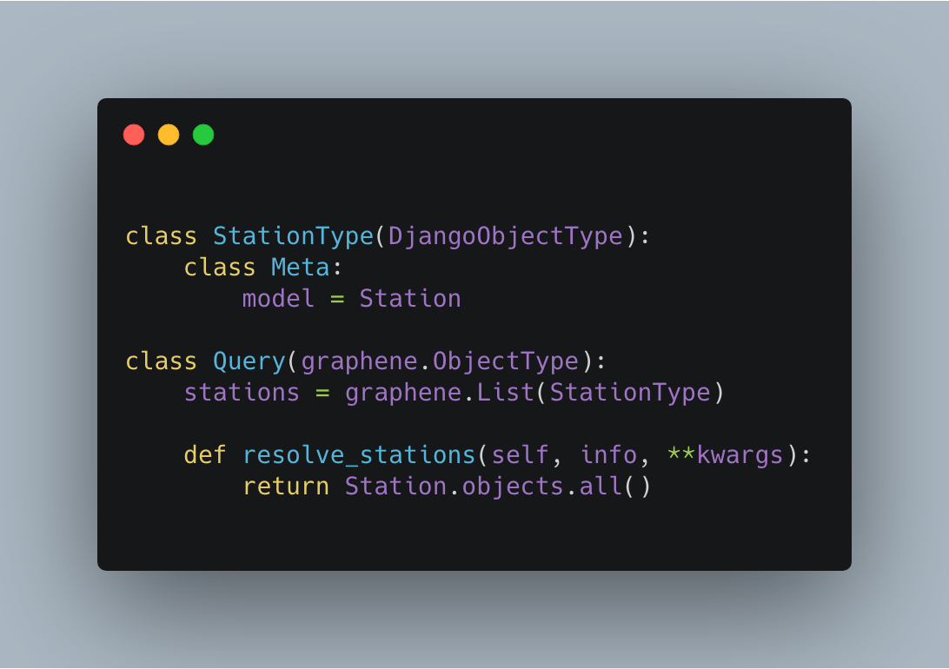
Crafting Stations - Query Stations

Slide 48
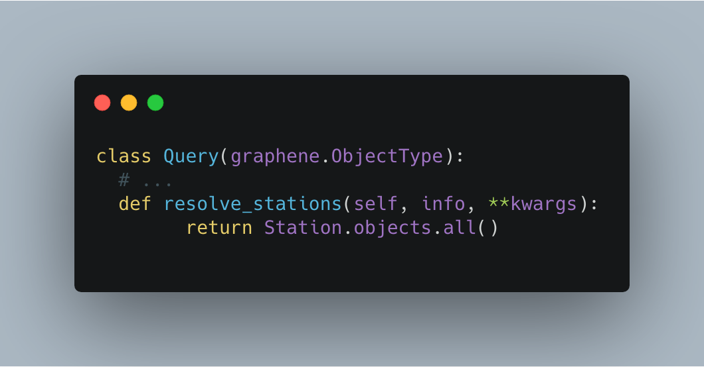
GraphQL Resolvers Zoomed In
A resolver defines (to the server) how we return schema objects when queried
Notes:
Note that we are using Resolvers here. A resolver is how GraphQL determines how to take an object type and return a set of properties. In the code above we are defining how when we query for stations, we will resolve the stations. In this case, we will return all the stations and the meta fields of Django’s properties will define what station properties get returned.
When creating a query in Graphene, you must implement a resolver!

Slide 49
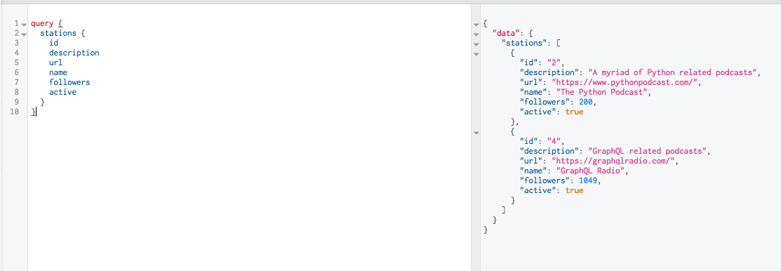

Slide 50
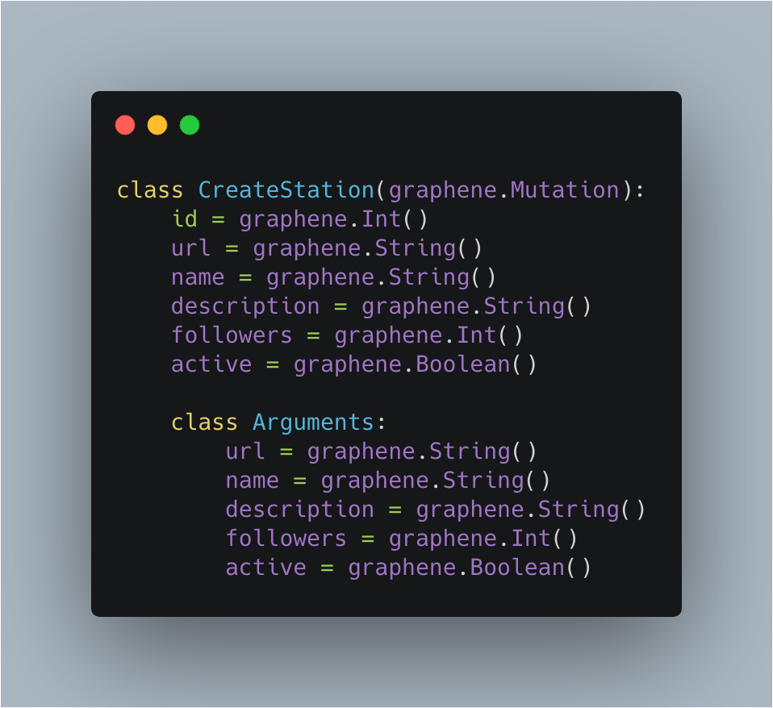
Crafting Stations - Create Station

Slide 51
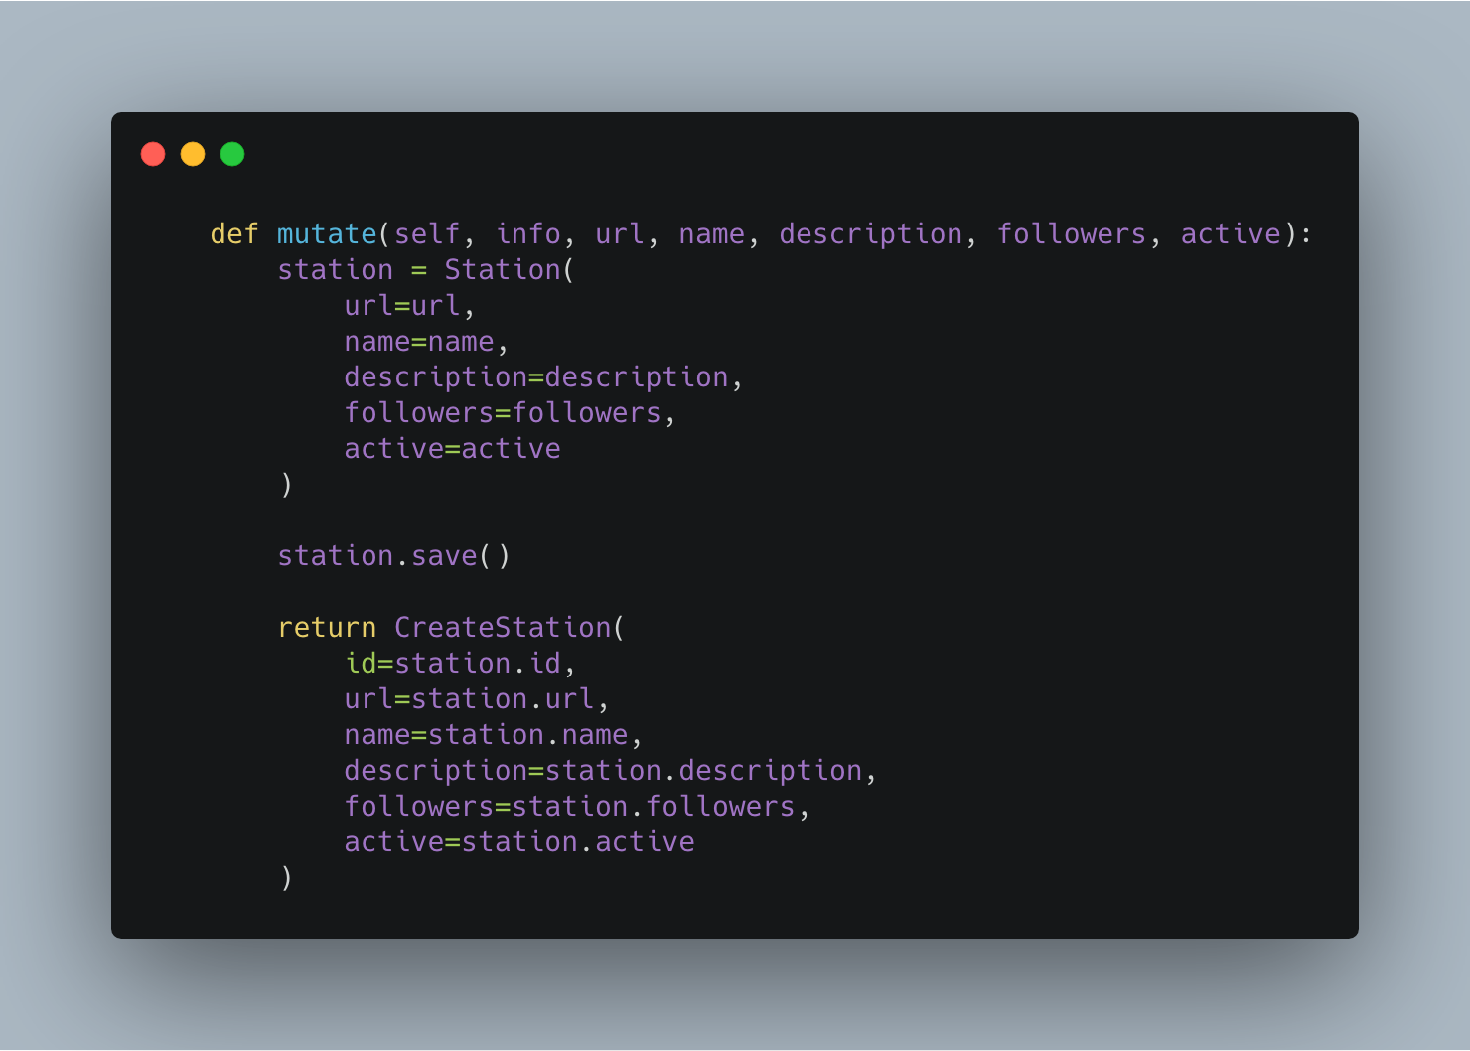

Slide 52
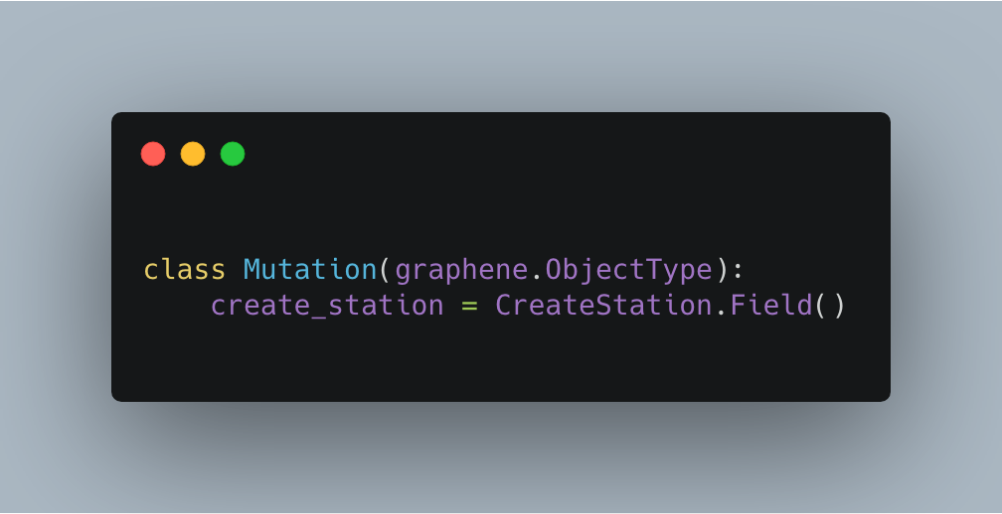

Slide 53
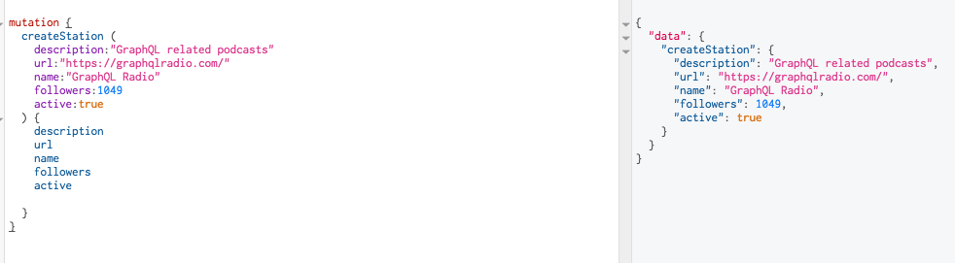

Slide 54
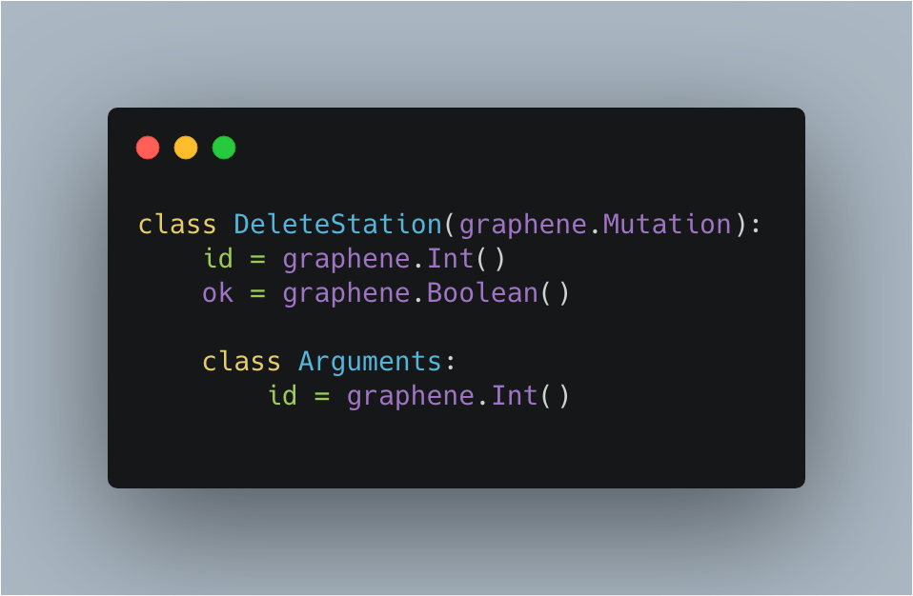
Crafting Stations - Delete Station

Slide 55
Crafting Stations - Delete Station

Slide 56
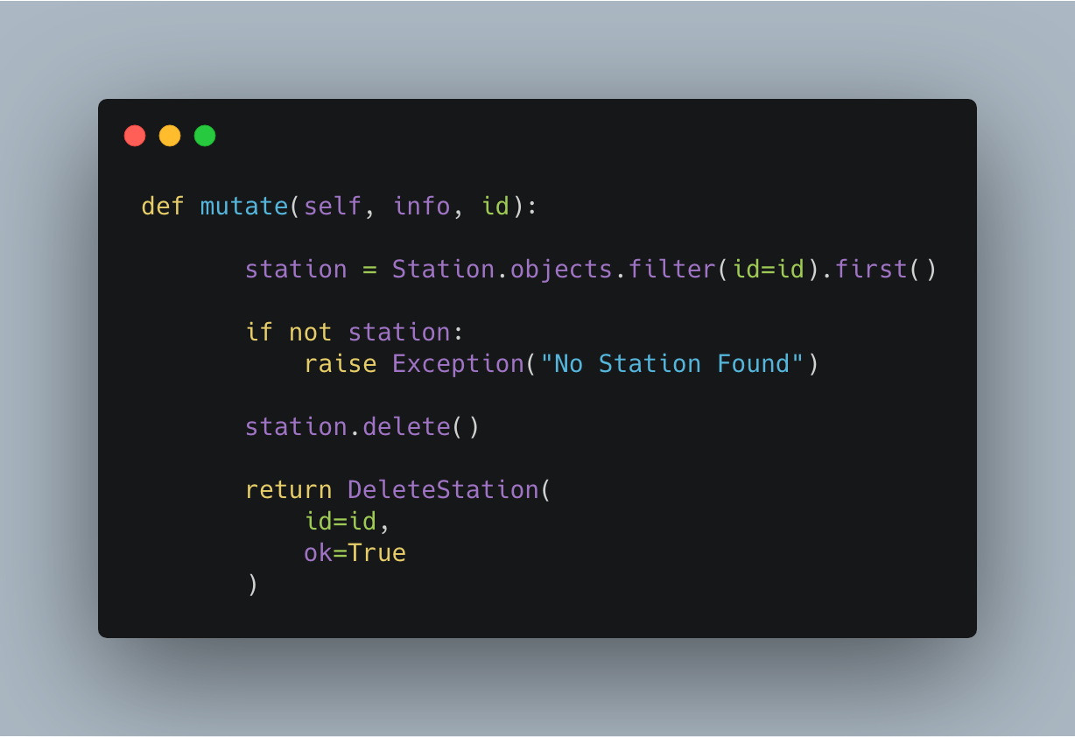
Crafting Stations - Delete Station

Slide 57
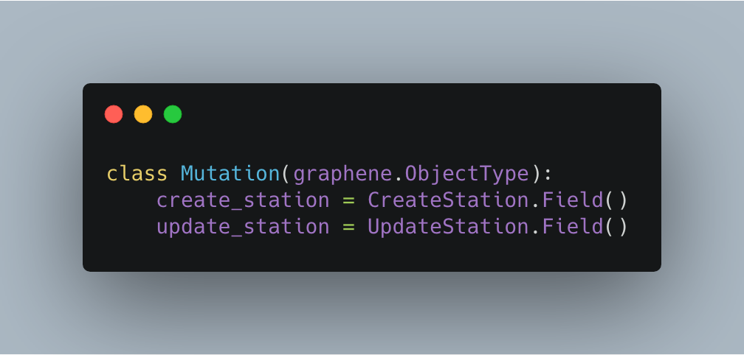
Crafting Stations - Delete Station

Slide 58
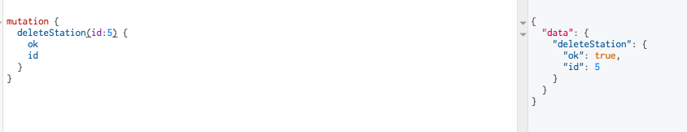

Slide 59
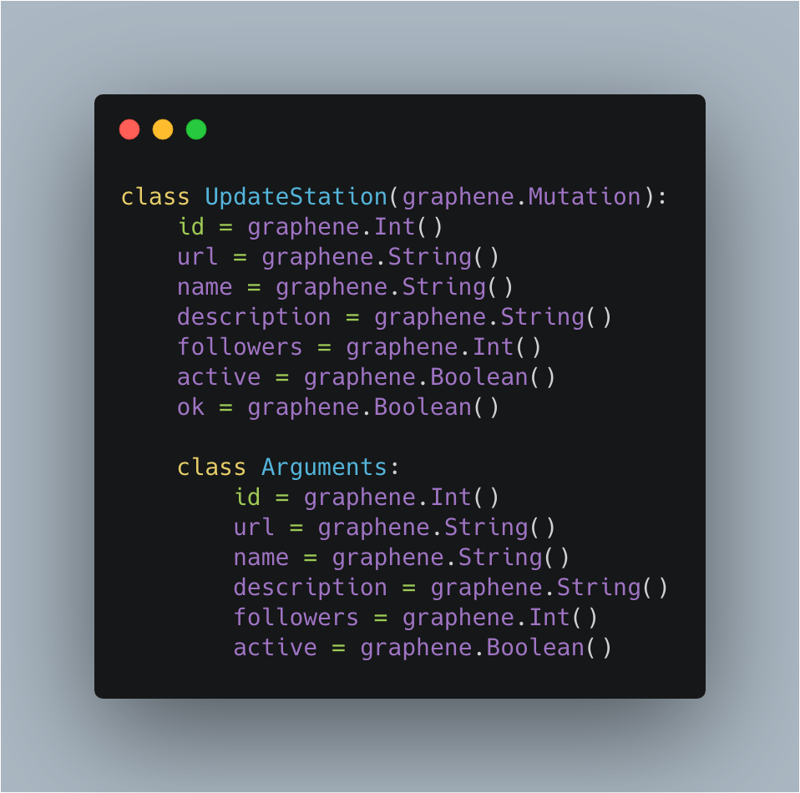
Crafting Stations - Update Station

Slide 60
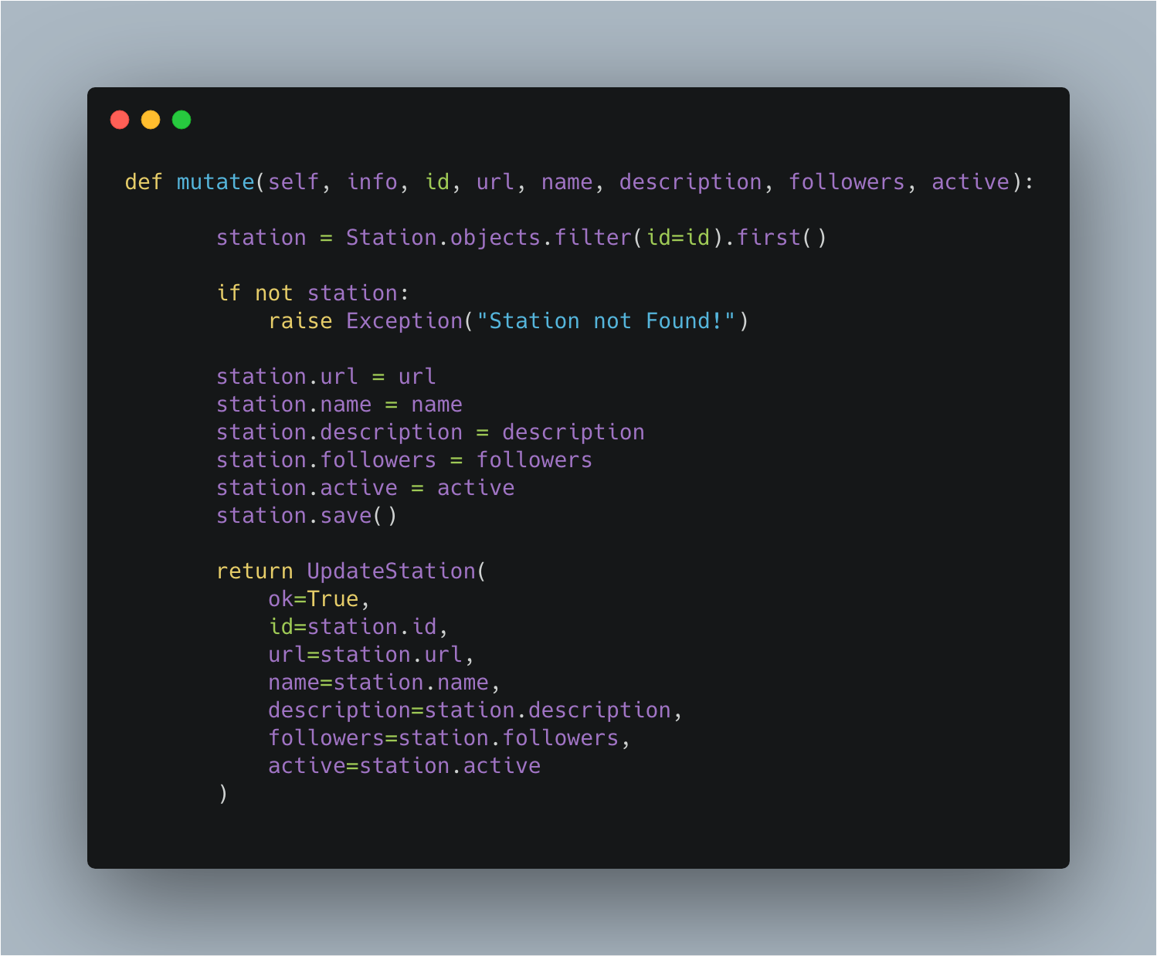
Crafting Stations - Update Station

Slide 61
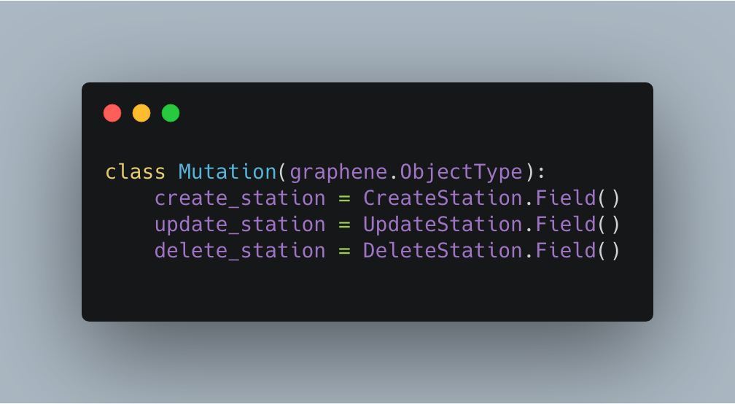
Crafting Stations - Update Station

Slide 62
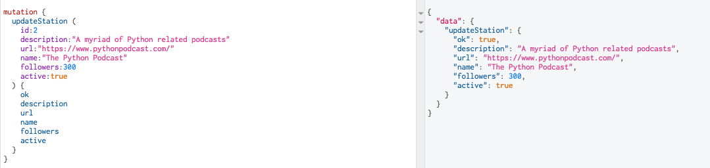

Slide 63
CRUD Complete!
Just like that we have a CRUD complete API
We will repeat the same for podcasts
Users is handled using graphql-jwt. This is used to leverage JSON web tokens with GraphQL and Django’s user model
Code can be found on
Notes:
So that is it, we have implemented a simple Station API. For the sake of brevity we are not going to cover making podcasts and users however the codebase can be found on.
We are going to look at some more interesting use cases.

Slide 64
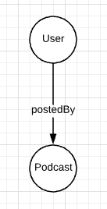
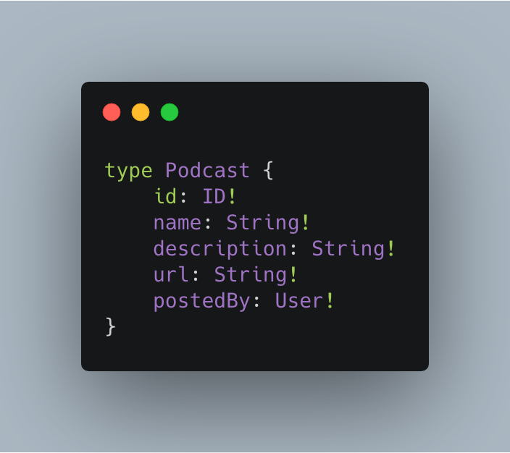
One-to-one connections modelling
Notes:
We establish a one to one relation by defining that the podcast is hosted by the station.

Slide 65
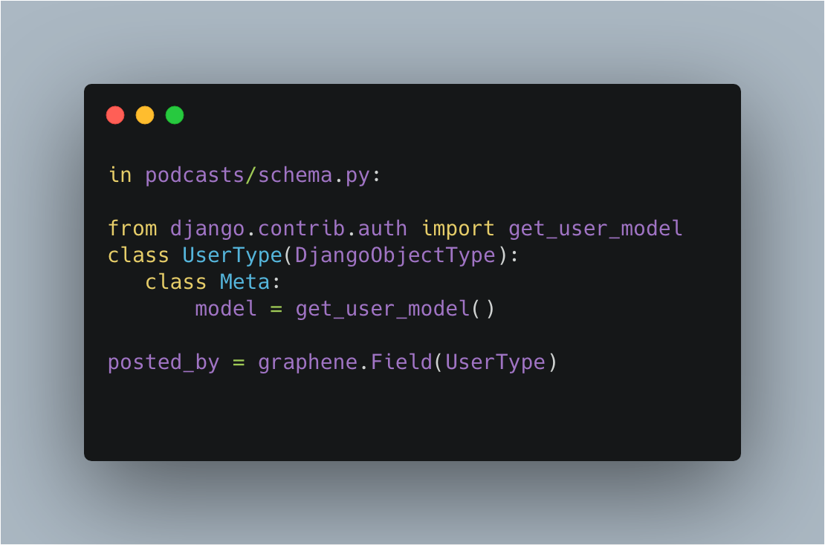
One-to-one connections modelling

Slide 66
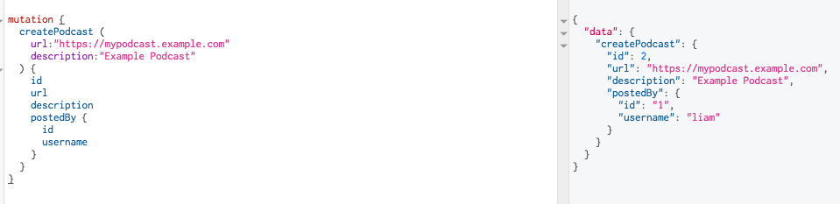

Slide 67
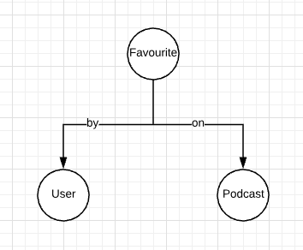
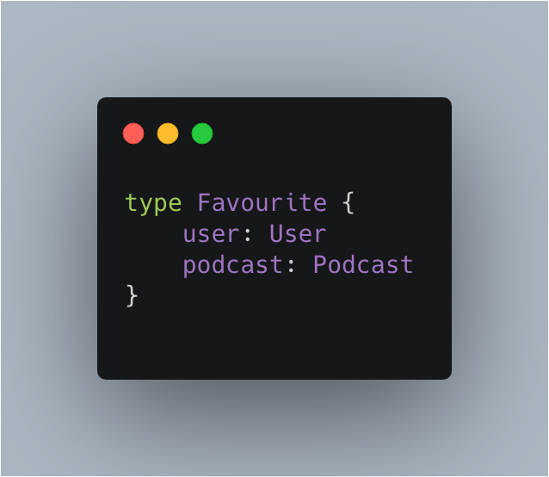
One-to-many connections - Favouriting Podcasts

Slide 68
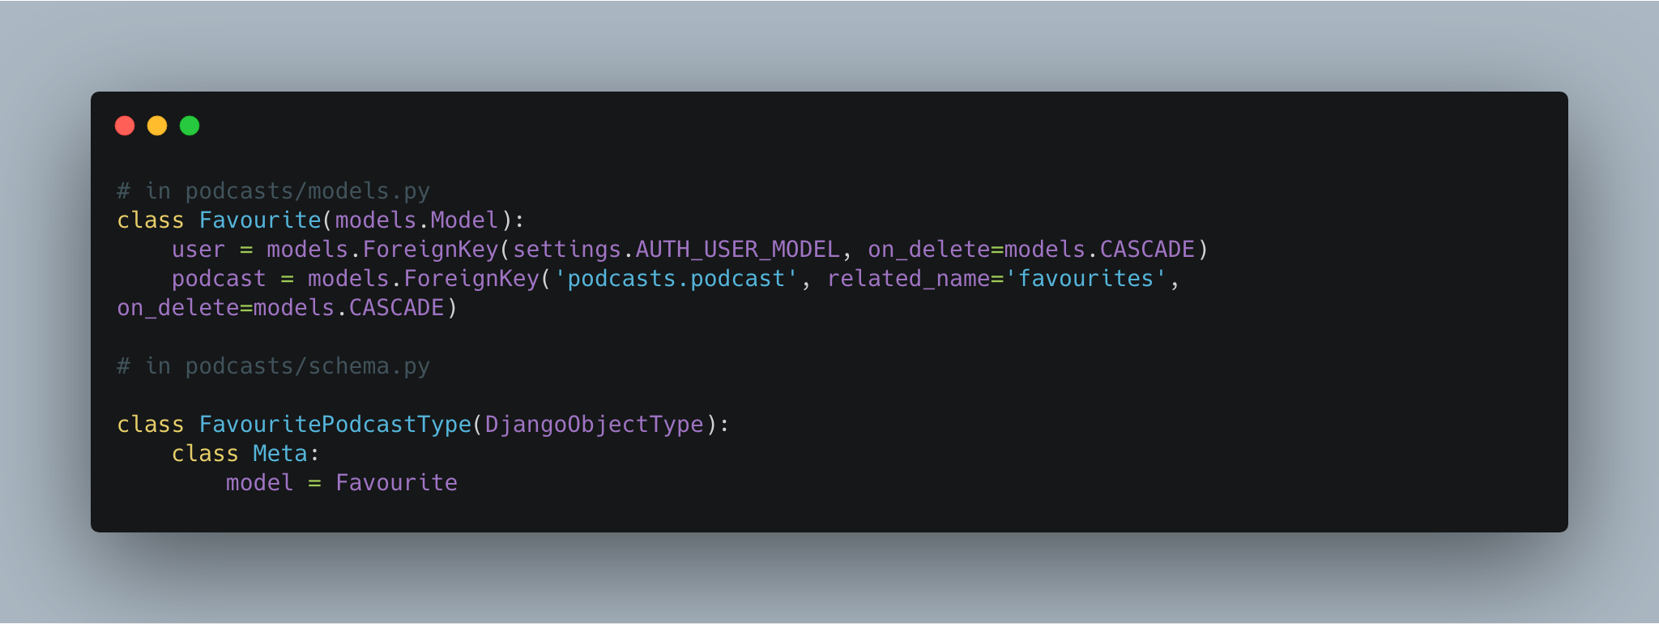
One-to-many connections - Favouriting Podcasts

Slide 69
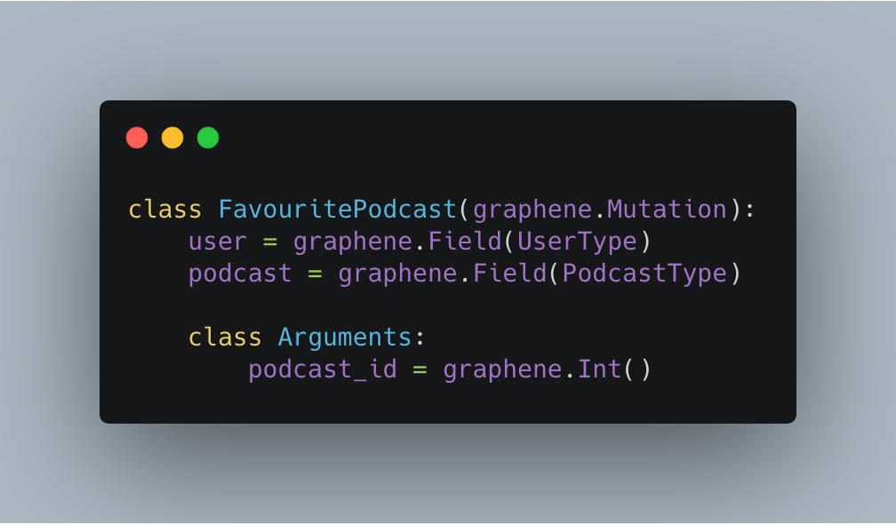
One-to-many connections - Favouriting Podcasts

Slide 70
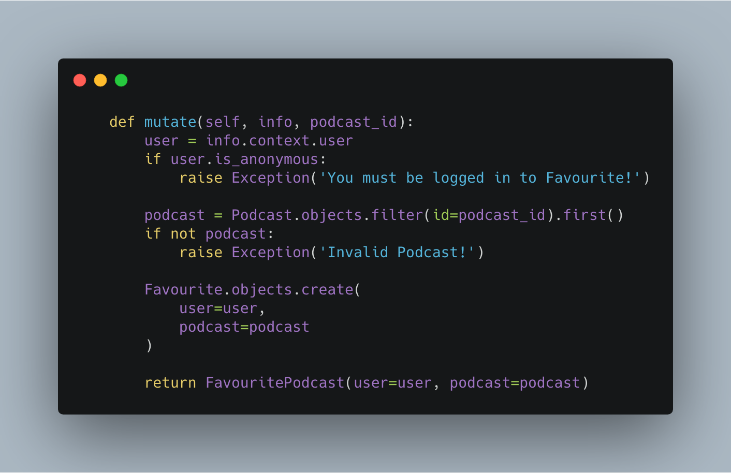
One-to-many connections - Favouriting Podcasts

Slide 71
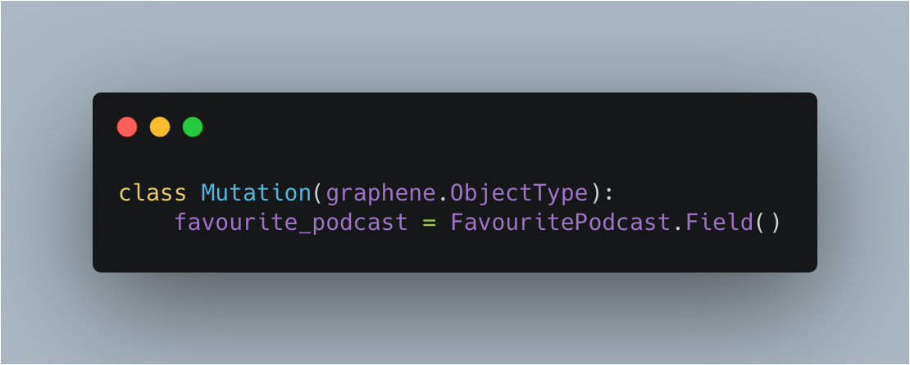
One-to-many connections - Favouriting Podcasts

Slide 72
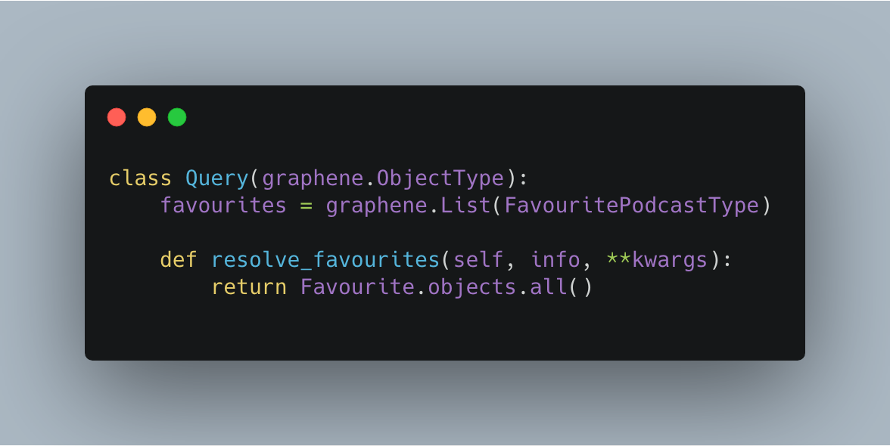
One-to-many connections - Querying Favourites

Slide 73

User is fetched from auth

Slide 74


Slide 75
DEMO TIME
🎉

Slide 76
WHEN NOT TO USE GRAPHQL
GraphQL is not a silver bullet.
Caching GraphQL queries can be difficult.
Useful in cases where you have complex datasets and evolving REST api’s.
Minimizes API calls but can hit database more (without caching layer).
We will repeat the same for podcasts
Users is handled using graphql-jwt. This is used to leverage JSON web tokens with GraphQL and Django’s user model
Code can be found on
Notes:
GraphQL is not a silver bullet. It does not replace REST in my opinion and is not always the best technology to use. Don’t follow the hype train.
Caching GraphQL queries can be difficult as there are more variations of queries that can occur however you can still use normal caching technologies like redis.
It’s more suited to cases where you have complex datasets and continuously evolving datasets similar to how Facebook has or if you have a taxonomy of products.
It minimizes API calls but if you do not cache effectively then it can lead to more database hits.

Slide 77

RESOURCES
Learning GraphQL Book
GraphQL Queries and Mutations
Graphene Docs
How to GraphQL
Graphene Types
GraphQL Python Guide
Notes:
These are some resources to learn more. Feel free to get the slides and check them out.

Slide 78
THANKS!
Any questions?
You can find me on twitter at
@liamjnorman

Slide 79
CREDITS
Presentation template by SlidesCarnival

